Slide 1
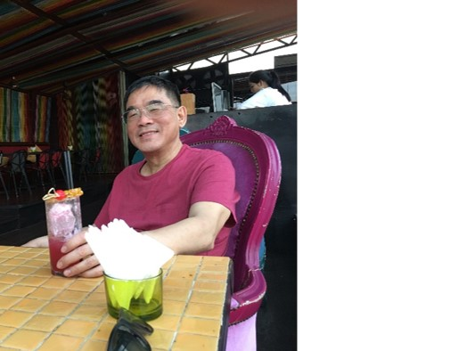
Database Lab 9
Set Op and Subquery Where
Addendum
Dr. Jefferson Fong

Slide 2
Slide 5
Recall Lab 8, Exercise 1, (and Lab 4, Exercise 1)
  Actor(actor_id, first_name, last_name)
  Film_actor(actor_id, film_id)
  Film(film_id, title)
BTW, note the relationship between Lab 8 Exercise 2 with Lab 4 Exercise 2.
Slide 6
Recall “union” in Lecture 9 slide 14, combine the columns.
Run the SELECT statement and see what happens.
Slide 7
Intersection is only supported in the latest version of MySQL
  Mac users and people who are not using the latest version of MySQL must use the IN Subquery instead (Slide 10-11).

Slide 3

Slide 9
Alternative for UNION: use WHERE $P_{A}$ OR $P_{B}$
Slide 10
Alternative for INTERSECTION - use IN (Slide 10-13)
Alternative to SET DIFFERENCE - use NOT IN (Slides 15-17)

Slide 4
Slide 18
Exercise 1: See Slide 9
Exercise 2: See Slides 12-13
Exercise 3: See Slides 16-17
Exercise 4: Recall Lab 8 Exercise 6.
  A customer who has not rented any film has rental_id as NULL.

Slide 5


